Slide 1

Analyzing the Job Market for Data Positions
Emily Chan
Raneen M Ali
Shakhawat Hassan
Valentina Pineda
Notes:
To analyze the market for data jobs.
Which position is the most profitable

Slide 2

AGENDA
Introduction
Data Positions by Company Type and Degree Requirements
Overview of Open Data Positions by Industry
Conclusion and Recommendations
Notes:
https://public.tableau.com/profile/victor7811#!/vizhome/DataScientistDataAnalystJobAnalysis-Glassdoor/PopularBackgrounds
https://public.tableau.com/profile/victor7811#!/vizhome/DataScientistDataAnalystJobAnalysis-Glassdoor/PopularBackgrounds
https://www.kaggle.com/jobspikr/data-scientist-job-postings-from-the-usa
https://www.kaggle.com/sl6149/data-scientist-job-market-in-the-us#fulltimeAL.csv data scientist Employment https://www.kaggle.com/refaee/data-scientist-employment
Job postings
https://www.kaggle.com/jobspikr/data-scientist-job-postings-from-the-usa/data
Values : that have a relationship with each other,

Slide 3

Introduction
Our mission is to analyze the data job market in the United states based on salary, position and company type. Through data visualization, we will evaluate the difference between data analyst and data scientist from a dataset.
The data set used to provide insight was extracted from Glassdoor it includes: location, position type, estimated salary, degree requirements and Industry type.
The 4 main differences between Data Analyst and Data Scientist
Notes:
Raneen - Explain each
Based on the Northeastern University Breakdown:
Data Analyst examine large data sets to identify trends, develop charts, and create visual presentations to help businesses make more strategic decisions.
Data Scientist: design and construct new processes for data modeling and production using prototypes, algorithms, predictive models, and custom analysis.
Data Analyst
Data Scientist
Develop answers and solution to question
Use data to formulate questions and decide which solutions benefit the business
Typically work on SQL and simpler structures with other tools
Build statistical models and be well versed in machine learning and advanced programming
Only address business problems
Give accurate prediction of the value of the business once the problem is solved
Make sure to mention a few technical skills for data analyst- Top data analyst skills include data mining/data warehouse, data modeling, R or SAS, SQL, statistical analysis, database management & reporting, and data analysis.
https://www.northeastern.edu/graduate/blog/data-analytics-vs-data-science/ - R
https://www.springboard.com/blog/data-analyst-vs-data-scientist/
https://www.quora.com/Why-do-data-scientists-earn-much-more-than-data-analysts-What-is-making-that-difference

Slide 4





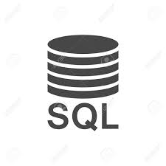


Data Analyst vs. Data Scientist
Data Analyst | Data Scientist
Develop answers and solution to question | Use data to formulate questions and decide which solutions benefit the business
Typically work on SQL and simpler structures with other tools | Build statistical models and be well versed in machine learning and advanced programming
Only address business problems | Give accurate prediction of the value of the business once the problem is solved
Technical skills- data mining/data warehouse, data modeling, R or SAS, SQL, statistical analysis, database management & reporting, and data analysis | Technical Skills- machine learning, software development, Hadoop, Java, data mining/data warehouse, data analysis, python, and object-oriented programming
Notes:
Raneen-
Data scientist requires more technical skills to make predictions
Based on the Northeastern University Breakdown:
Data Analyst examine large data sets to identify trends, develop charts, and create visual presentations to help businesses make more strategic decisions.
Data Scientist: design and construct new processes for data modeling and production using prototypes, algorithms, predictive models, and custom analysis.

Slide 5
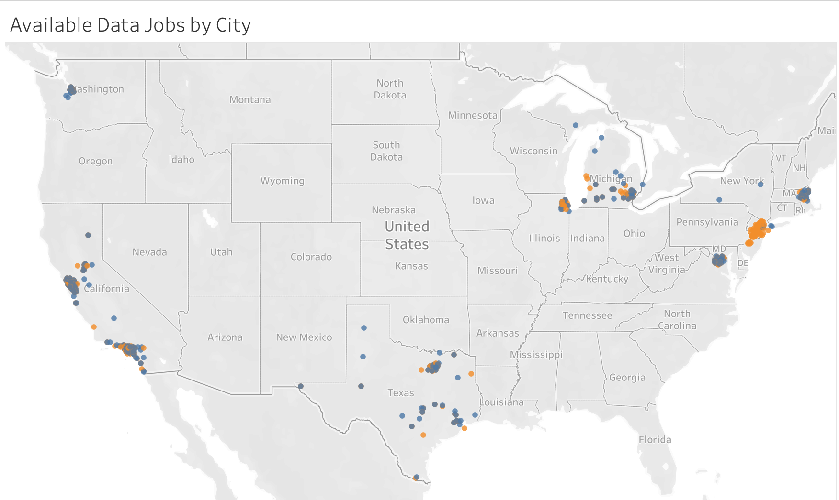
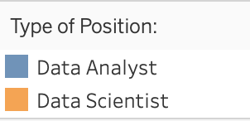
Open Data Positions by City
Notes:
Valentina-
According to Glassdoor’s list, Data Scientist has been named the best job for three years in a row(2017-2019) it currently ranks in #3 for 2020, other data analytics and science jobs also made the list including Data Analyst, Analytics Manager and Database Administrator.
The dataset we obtained from glassdoor has a total of 6,086 open positions for data jobs with about 3,600 for data scientist noted in orange and about 2,450 for data analyst noted in blue. This map is an overview of the “location filter used in search” for our data set. This dataset does not look at data jobs across the US it rather looks into some of the TOP cities/states with data positions available in the country (San francisco, Los angeles, texas, washington DC,NYC and NJ) That is not to say that there aren’t data science positions all across the country. If you are currently looking for a position in data, there is no lack of opportunity.

Slide 6
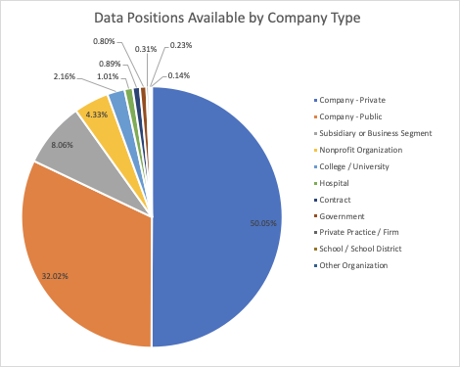
Positions Available by Company Type
Top 3 Company Types with the most Available Open Positions:
Private
Public
Subsidiary or Business Segment
*Aggregate of total jobs collected within an industry between DA / DS roles.
Notes:
to provide a starting point in the search for data jobs we first looked into the positions available by company type and found that the private campanies at 50% closely followed public sector (32%) have the most positions available- so private companies might be a good start as the job openings are 50 % in this sector furthermore

Slide 7
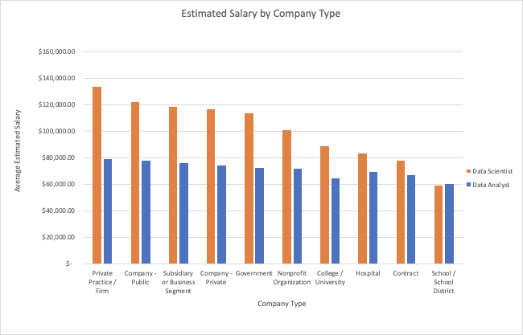
Salary by Company Type
Top 3 Company Types with Highest Average Salary:
Private Practice/ Firm
Public
Subsidiary or Business Segment
Notes:
Valentina-
To provide more insight we looked into salary by company type and found that private practice/ firm closely followed by public companies have the highest average estimated salary. We can also note Data Science positions consistently show a higher salary than a Data Analyst
analyzing company types by open positions and salary Both the private and public sector are promising with data jobs this just depends on your key decision factor when looking for a role money or growth?
If you are looking for growth and career development public companies are larger and usually offer faster promotions and also tend to have more resources to help employees train and further their education while on the job.
But If your paycheck is the key decision factor for where you want to work, you might want to look into private practices or firms these companies aren’t as well know as public companies so they offer better pay and incentives to attract the best employees
Public companies, which are usually larger and have more management positions than private firms, can usually offer faster promotions. They also tend to have more resources to help employees train and further their education while on the job.
But If your paycheck is the key decision factor for where you want to work, you should probably aim for a private company. Most privately owned companies pay better than their publicly owned counterparts. One reason for this is that, with many exceptions, private companies aren't as well known, so they need to offer better incentives to attract the best employees. Private companies also tend to offer more incentive-based pay packages.

Slide 8
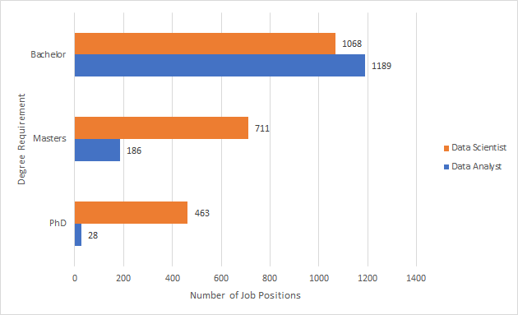
Number of Job Positions Available Based on Degree Requirements
Notes:
Shak
Based on our research, data Analysts are more like entry to the data job industry. This role does not require you to have masters or higher degrees. On the other hand, Data Scientists are required to have higher degrees and more technical skills such as Machine learning, knowing the big data, more into prgming. By looking at this graph, as you can see Data Scientists are going for Masters and PhD. Therefore, there are more data analysts positions are available for bachelor’s degrees holder.
For example, data scientists are required to have Masters degrees for 711 positions while data analysts have 186 required Masters degree positions.

Slide 9
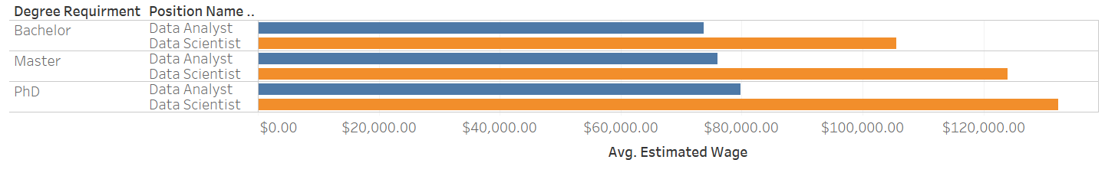
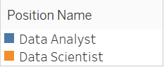
Avg. Estimated Salary & Degree Requirements
Notes:
Shak
ow up for previous slide, this graph shows how much data analysts/scientists are earning based on their degrees. If you have the technical skills and want to gain more tech skills, you should be considering your role as a Data Scientist.
For example, Avg Estimated Salary ($)
Bachelor: DA: 75K
DS: 110K
Masters: DA: 80K
DS:120K
PhD: DA: 85K
DS: 125K

Slide 10
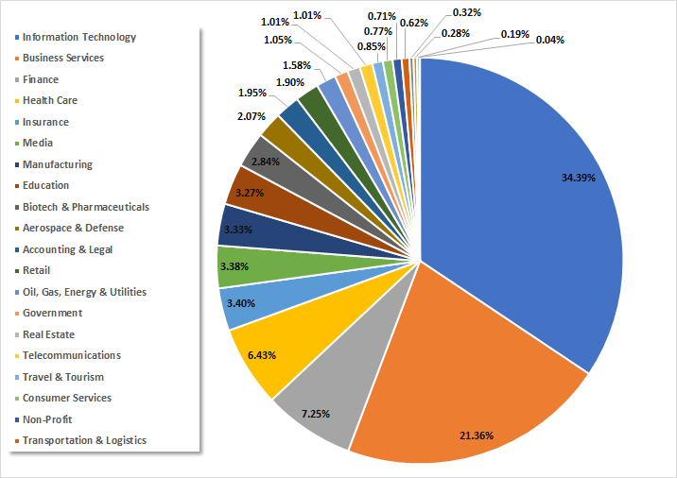
Overview of Open Data Positions By Industry
Top 5 Industries With Most Available Open Positions:
Information Technology
Business Services
Finance
Health Care
Insurance
*Aggregate of total jobs collected within an industry between DA / DS roles.
Notes:
Emily
Here is an overview of open data jobs by industry. The data shown here is a total of all open positions within an industry and the combined number of positions between Data Analytics and Data Science roles.
The industries with significant amount of openings for jobs in data are Information Technology and Business Services. There are a variety of industries to enter into for those who are interested in pursuing a career in data. However, the data shows you might have a better chance of finding more open positions within the IT / Business Services industry than with other listed industries.
“From the data analyzed the top 5 industries that have the most available open positions are (mentioned the five), this implies that there is a variety of industries in data however based on the analysis when searching for jobs you might have more luck finding open positions in the 5 mentioned” -V

Slide 11
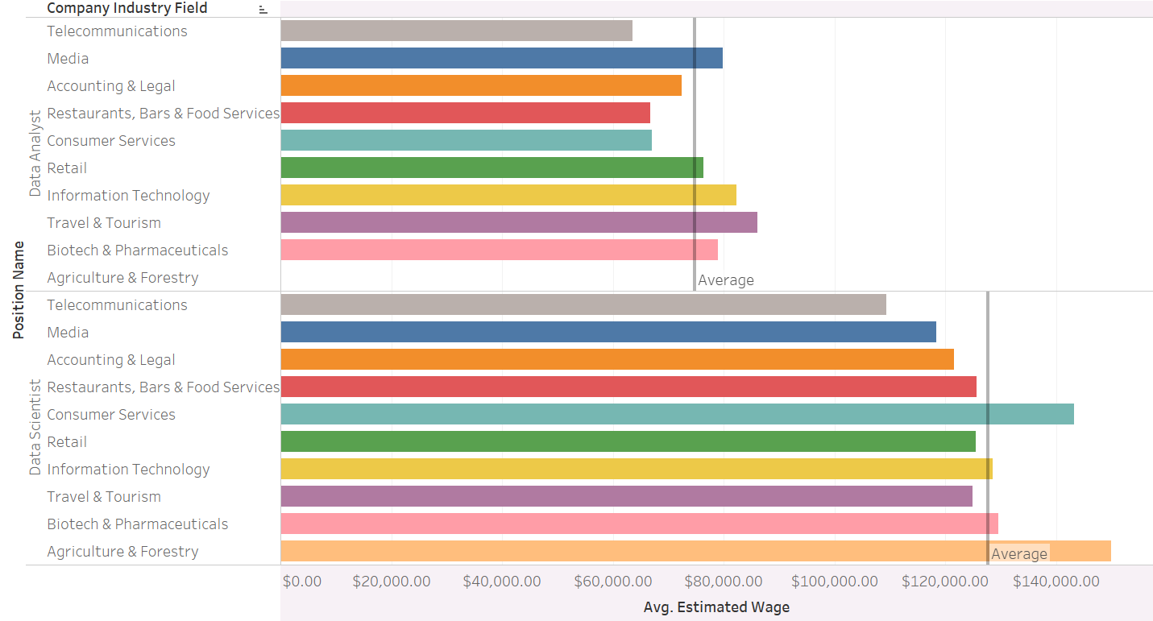
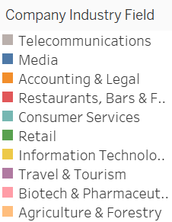
Industry Type & Avg. Estimated Salary
Notes:
Emily
Of the 24 industries that were sampled in the data set, we chose to highlight 10 industries with the highest estimated average salary and to see the difference in salary within these industries between a Data Analyst and Data Scientist Role.
We found that...
The average estimated salary for a DA role within these 10 industries is $74,821.28.
The average estimated salary for a DS role within these 10 industries is $127,674.41.
Noticed from the data that based on the average estimate, Data Science roles consistently show that the salary will typically be higher than a Data Analyst across all industries that were sampled in our data set. It’s possible that the amount and level of skill needed for the average day-to-day role of Data Scientist contributes to the higher paying salary.
While it is shown that Agriculture has the highest estimated average salary, I just want to note that our data did not collect any information on Data Analyst roles within the this industry.
Agriculture the highest avg. salary here for data scientist but there was no data for Data analyst roles in this industry. It possible that the day to day for this role involves more technical skills such as advanced modeling techniques, and programming skills.

Slide 12
How is Data Utilized in Certain Industries?
AGRICULTURE & FORESTRY:
Manage Crops & Diseases
Combat Climate Change
Make Yield Predictions
BIOTECH & PHARMACEUTICALS:
Research & Development
Conduct & Analyze Clinical Trials
Blockchain / AI / Machine Learning
TRAVEL & TOURISM:
Route Optimization
Personalized Market & Customer Segmentation
Sentiment Analysis
Notes:
Emily
Agriculture:
In Agriculture IoT (Internet of Things) technology can be used to communicate real time data.
For climate change, IoT sensors can collect live data about crops and send that information into a database. DS can look for ways to optimize production cycles when climate change has impacted the traditional farming cycle.
Biotech/Pharma:
Drug R&D involves storing a lot of information and data on the development process, lab testing, and preclinical studies. Companies also want to make sure that this information is securely kept in the database due to the competitive environment of the industry.
AI / Machine Learning to create comprehensive models and understanding of medical diseases. For ex, machine learning is being used to predict treatments for COVID.
Travel/Tourism:
Data can be used to optimize the logistics of a trip by analyzing ways to minimize travel costs and distance and to employ better time management to create the best experience for the consumer.
In this industry, sentiment analysis is also used to analyzing text data, such as reviews left on booking websites to learn about the behavioral and emotional implications behind a text. These websites often coordinate with travel agencies and hotels by offering them insights into sentiment analysis.
https://towardsdatascience.com/6-ways-the-agricultural-industry-is-benefiting-from-data-scientists-b778d83f61db [agriculture]
https://towardsdatascience.com/when-the-pharma-giants-met-the-tech-giants-b29a530ed1b1 [bio/pharma]
https://www.kdnuggets.com/2019/02/top-7-data-science-use-cases-travel.html[travel/tourism] - though maybe not so relevant now considered with what’s going on. Maybe can think about how travel/tourism has dipped due to coronavirus.

Slide 13
Conclusion
Which data track is right for you? What is your preferred way of working with data?
Data Analysts work with large data sets to identify trends and create visualizations to help businesses make better strategic decisions.
Data Scientists work with data by designing advanced data modeling and automation frameworks.
Of the two positions, our data showed that Data Scientist has the highest estimated avg. salary.
Notes:
Emily
Throughout our analysis and research we found that the difference between a Data Analyst and Data Science positions is with how data is handled and worked with on a day-to-day basis.
Overall our data showed the DS positions have a higher estimated avg. salary and is a more specialized role. However, DA positions can also serve as a great entryway into the world of data.
Data scientists also make more money considering the advanced skills required.
Conclude by, saying that at the end of coop, if there’s interest in DS, then you can learn hard skills relating to DS and more coding language skills. Because DA is seems like the entry point into the world of data. Check out jobs in DS or learn more coding skills if you feel that is the career path for you.
Recommendations for further analysis - popular positions, growth of

Slide 14

Recommendations
If Data Science is the career path for you…
Additional studying and acquisition of other skills is needed outside of COOP.
Location limitations on the dataset we used.
Analyzing the job market after COVID-19.
Notes:
Limitations on the datasets , look into data jobs available all across the country as opposed to the top cities hiring for this positions. -V
Something we wished the data set had.
In depth study on hard and soft skills needed on the job.
Job market after covid-19 in 2020

Slide 15
Sources
https://www.northeastern.edu/graduate/blog/data-analytics-vs-data-science/
https://www.springboard.com/blog/data-analyst-vs-data-scientist/
https://www.quora.com/Why-do-data-scientists-earn-much-more-than-data-analysts-What-is-making-that-difference
https://towardsdatascience.com/6-ways-the-agricultural-industry-is-benefiting-from-data-scientists-b778d83f61db
https://towardsdatascience.com/when-the-pharma-giants-met-the-tech-giants-b29a530ed1b1
https://medium.com/the-enterprise-diary/use-of-data-science-to-step-up-in-travel-industry-426544642870 .
Notes:
https://www.northeastern.edu/graduate/blog/data-analytics-vs-data-science/ - R
https://www.springboard.com/blog/data-analyst-vs-data-scientist/
https://www.quora.com/Why-do-data-scientists-earn-much-more-than-data-analysts-What-is-making-that-difference
https://towardsdatascience.com/6-ways-the-agricultural-industry-is-benefiting-from-data-scientists-b778d83f61db
https://towardsdatascience.com/when-the-pharma-giants-met-the-tech-giants-b29a530ed1b1
https://medium.com/the-enterprise-diary/use-of-data-science-to-step-up-in-travel-industry-426544642870

